Slide 1

TECH MAHINDRA
PRESENTED BY:-
K. KRISHNA MANIKANTA
A. VARUN KUMAR
B. DURGA PRASAD
T. SAI GOWTHAM

Slide 2
Part1: brand study, competitor analysis &buyer’ /audience’s persona * research brand : We are an enterprise driven by our promise to deliver Connected Experiences for the Connected World. We thrive on Change to create a better future for our customers, partners, associates, and stakeholders. Change that empowers us to innovate, collaborate and care. * missions/values : Our culture rests upon a set of core values that guide our actions, both personal and corporate. Our core values - good corporate citizenship, professionalism, quality focus, customer-first, and dignity of the individual - inspire our associates to achieve our core purpose.

Slide 3

Tech Mahindra's unique selling proposition (USP):- lies in its ability to provide end-to-end digital transformation solutions and services to its clients. Here's a short note on its USP:
Tech Mahindra's USP:
Dgital Transformation Expertise: Tech Mahindra is known for its deep expertise in digital technologies, including AI, IoT, blockchain, cloud computing, and cybersecurity. They help businesses harness the power of these technologies to drive innovation and growth.
Global Presence: With a global footprint and a diverse workforce, Tech Mahindra can offer clients a truly global perspective and access to a wide range of talent and resources.
Industry Focus: Tech Mahindra caters to a wide range of industries, including telecom, healthcare, finance, manufacturing, and more. This industry-specific knowledge allows them to tailor solutions to unique sector challenges.

Slide 4

Smart goals:- Specific: Goal: Expand the company's presence in the healthcare sector. Measurable: Goal: Increase annual revenue by 15% in the next fiscal year. Achievable: Goal: Achieve a 95% customer satisfaction rating in the telecom sector within the next 12 months. Relevant: Goal: Enhance cybersecurity capabilities to stay relevant in the fast-changing technology landscape. Time-bound: Goal: Launch a new software product within the next 9 months.
KPI’S:- Revenue Growth: The year-over-year increase in revenue reflects the company's financial health and business growth. Customer Satisfaction (CSAT): Measuring customer satisfaction through surveys and feedback allows Tech Mahindra to ensure that clients are content with the services provided, which is crucial for maintaining long-term relationships and securing repeat business. Employee Utilization Rate: This KPI measures the percentage of billable hours versus available hours for employees. Project Delivery Time: Tracking the time it takes to complete projects helps ensure timely delivery and client satisfaction. Quality Metrics: Monitoring quality-related KPIs such as bug rates, code review feedback, and adherence to quality standards ensures that the company maintains a high standard of service.

Slide 5

Buyer’s/audience’s persona:
Enterprise IT Decision Maker:
Role: CIO (Chief Information Officer), IT Director, or IT Manager.
Key Characteristics: Responsible for technology strategy, innovation, and decision-making within large organizations.
Needs: Seeking IT solutions, consulting, and services to drive digital transformation, improve efficiency, and stay competitive.
Industry-Specific Executive:
Role: CEOs, CFOs, or other top executives within various industries (telecom, healthcare, finance, manufacturing, etc.).
Key Characteristics: Concerned with industry-specific challenges and opportunities, such as compliance, customer experience, and operational efficiency.
Needs: Customized technology solutions that address sector-specific issues and improve business outcomes.
IT Project Manager:
Role: IT project managers or team leaders.
Key Characteristics: Focused on successful project execution, budget management, and timely delivery.
Needs: Reliable technology partners, software development, and consulting services to achieve project goals.

Slide 6

Compitetor analysis:-
.
COMPITETORS | STRENGTH | WEEKNESS | OPPURTUNITES | THREATS
Tata Consultancy Services (TCS) | TCS consistently delivers strong financial results, with steady revenue growth and profitability. | The IT services industry is highly competitive, with multiple global and regional players. | TCS can continue to expand into new markets, especially in regions where digital adoption is on the rise, such as Asia and the Middle East. | Staying at the forefront of technological advancements is a challenge in the IT industry.
Infosys | Infosys has long-term relationships with many leading global companies. | The IT services industry is highly competitive, with numerous global and regional players. | Strategic acquisitions and partnerships can help Infosys expand its capabilities and enter new markets more quickly. | Remaining at the forefront of technological advancements is a challenge in the IT industry.
Wipro | Wipro has established long-term relationships with numerous leading global companies. | Wipro derives a significant portion of its revenue from the North American market. | Strategic acquisitions and partnerships can help Wipro expand its capabilities and enter new markets more quickly. | Remaining at the forefront of technological advancements is a challenge in the IT industry.

Slide 7

sunday | monday | tuesday | wednesday | thursday | friday | saturday
1 | 2 | 3 | 4 | 5 | 6 | 7
 | ebook | Curated content |  | Wedinar | Group engegment
 | Curated content
 |  | Evergreen\updated blogs |  | E book
 | New blogs
8 | 9 | 10 | 11 | 12 | 13 | 14
 | Product launch |  | Product launch |  | webinar
 | Twitter chat |  | webinar
15 | 16 | 17 | 18 | 19 | 20 | 21
 | Twitter chat |  | Product launch | Campaing-1 | Campaing-1
 |  |  | Campaing-1 |  | Group engagement
22 | 23 | 24 | 25 | 26 | 27 | 28
 | holiday | holiday | holiday |  | Group engagement
 | New blogs | New blogs | New blogs
29 | 30 | 31 | Key happenings
 | webinar |  | New blogs | Campaing-1 | Product launch | Twitter chat
 | Evergreen/updated blogs
 |  |  |  | E book
 |  |  |  |  | webinar
 |  |  | holiday
 |  |  |  |  |  | others
 |  |  |  | Curated content
 |  |  |  |  | Group engagement
 |  |  | Evergreen/updated blogs

Slide 8

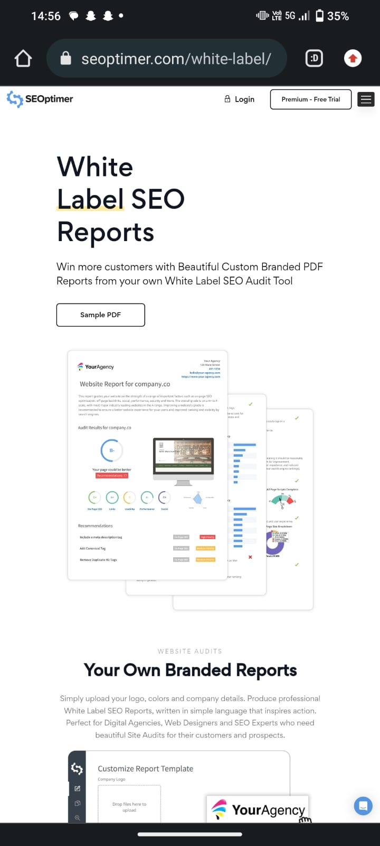
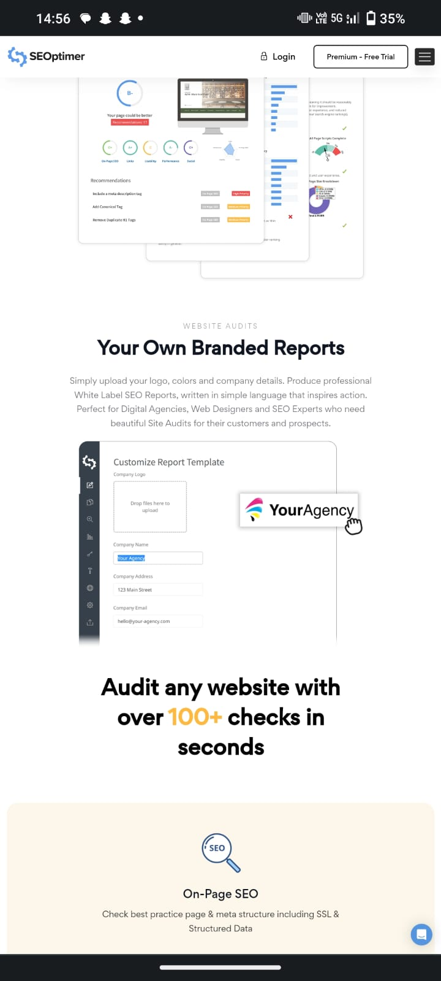
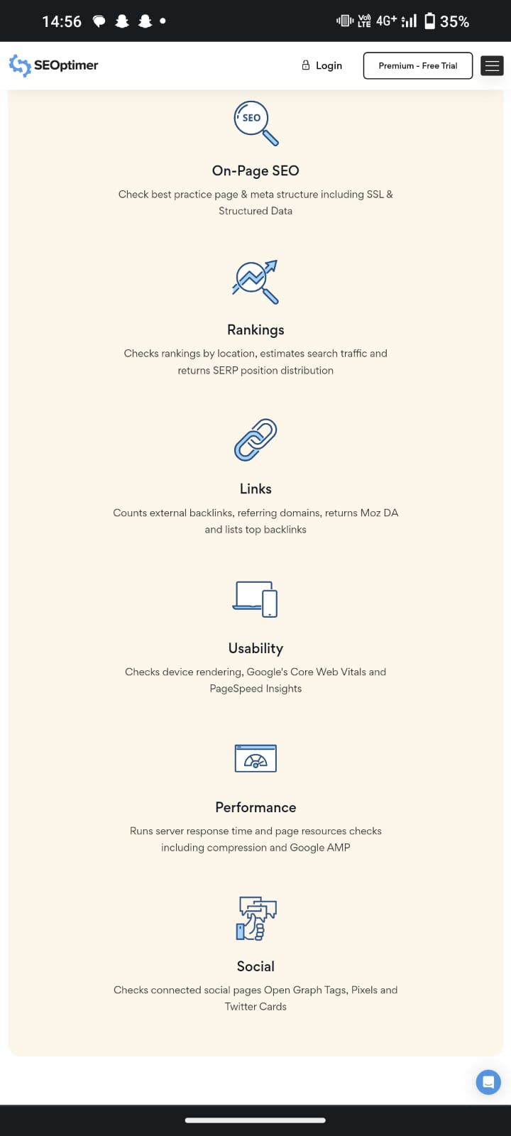
Seo audit:-

Slide 9
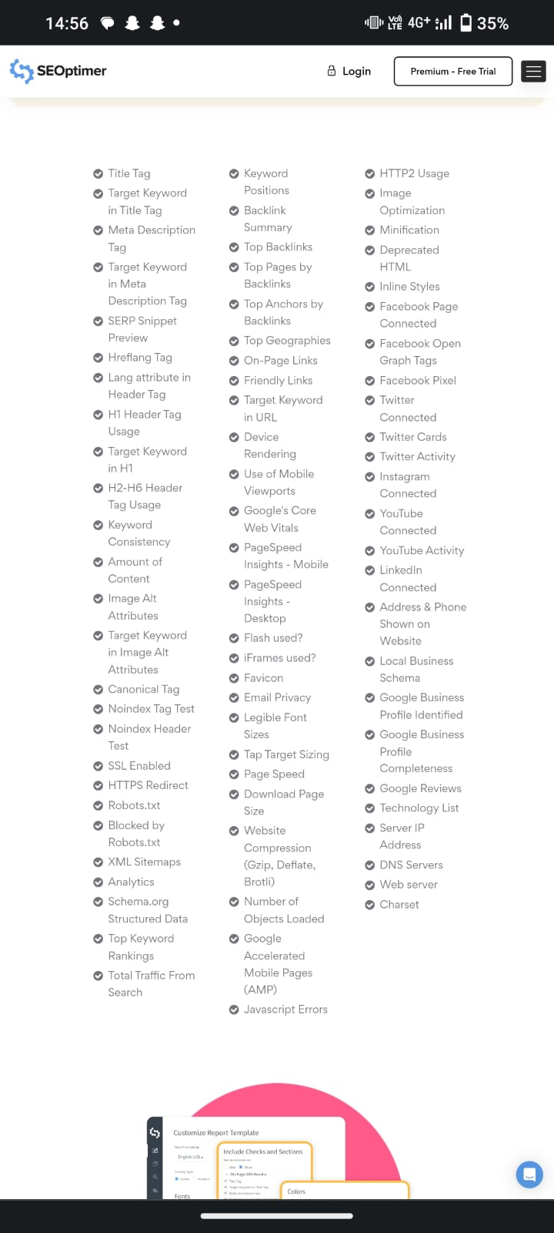
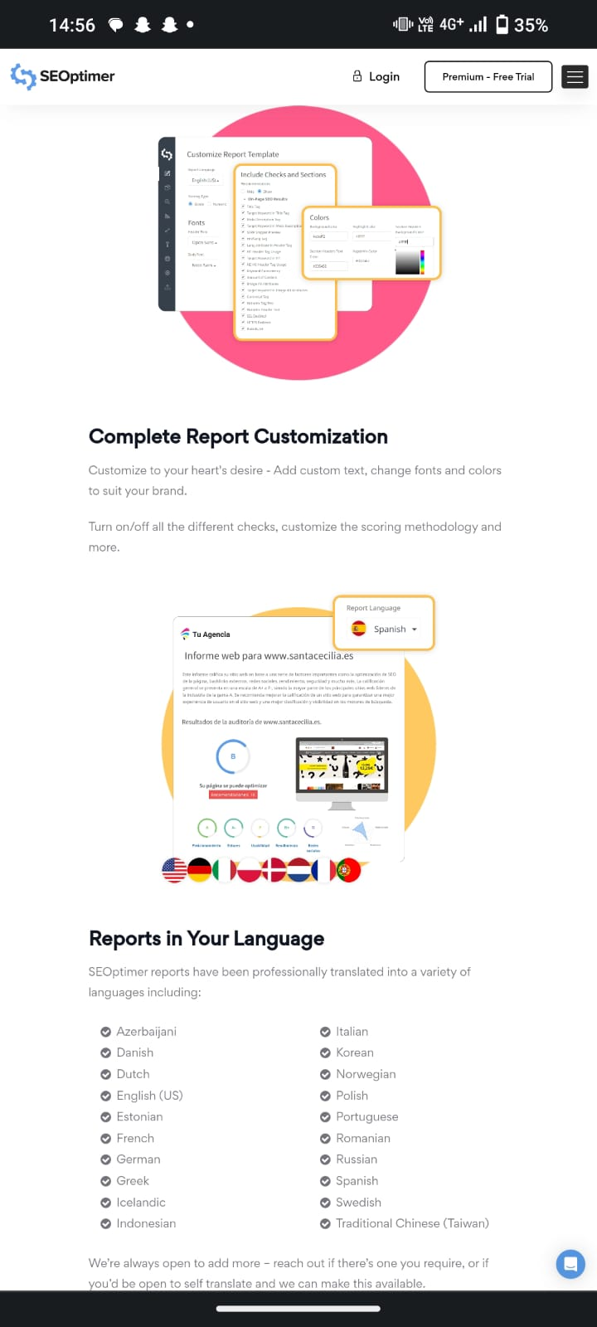

Slide 10
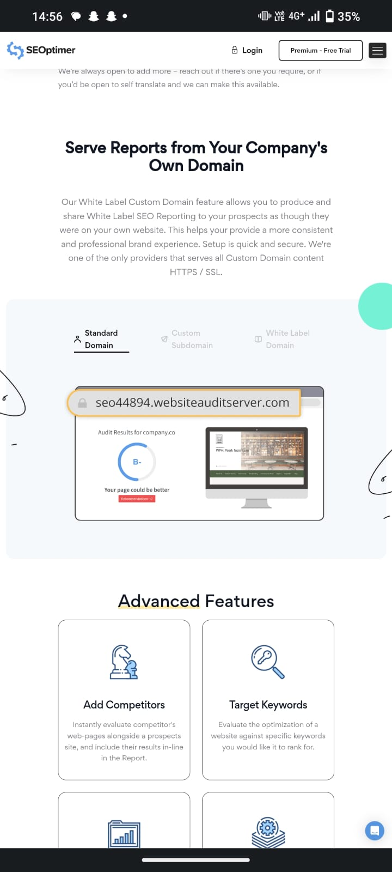
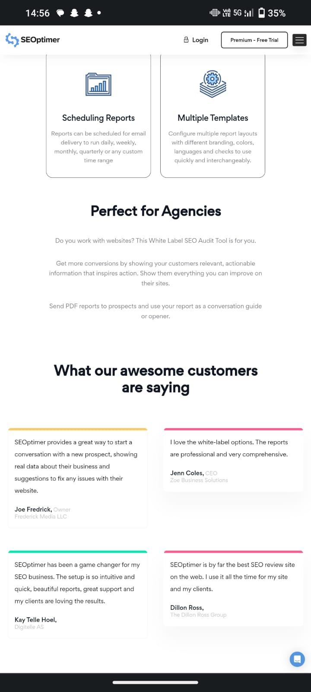
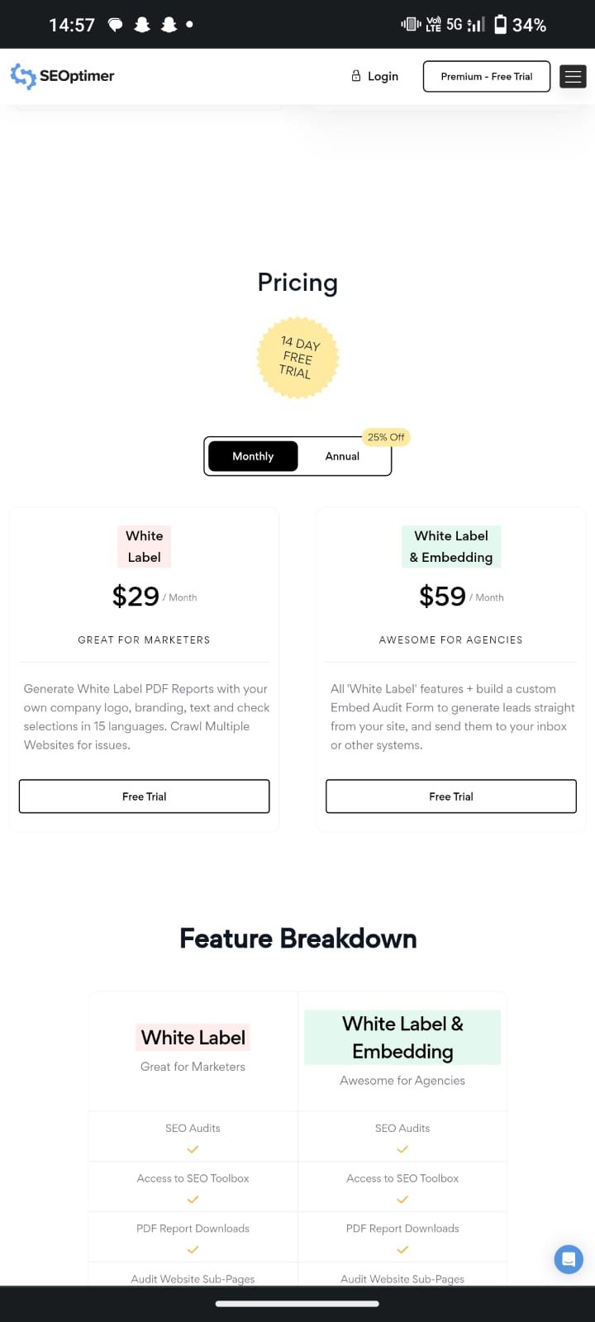

Slide 11
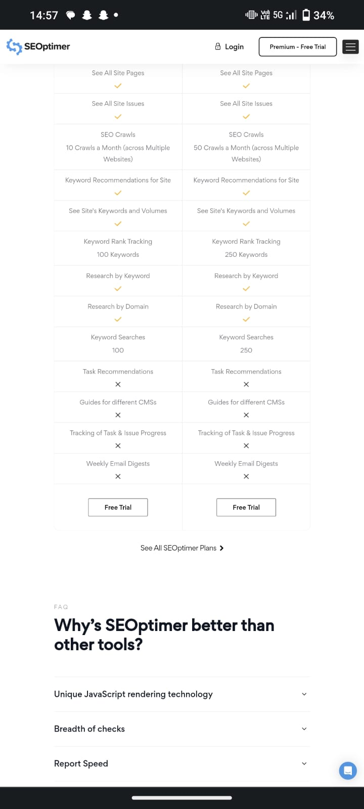
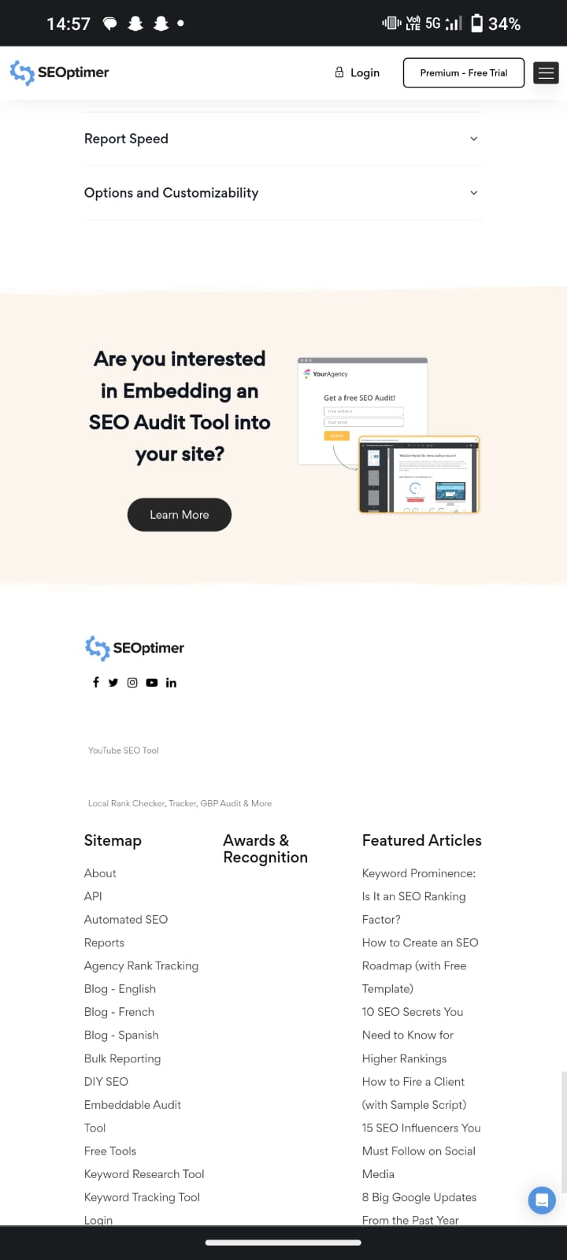
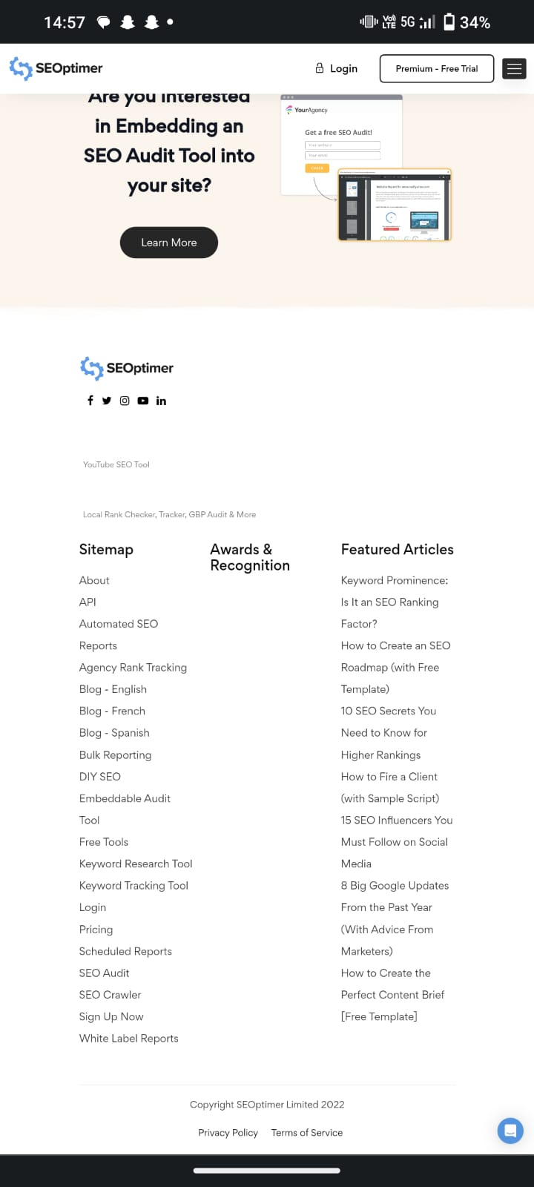

Slide 12
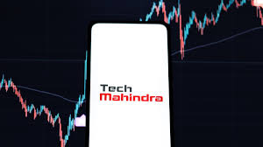
Key word research:-
key word | volume | compitetion | kei
Tech mahindra | 9200 | 57 | 28
Tech Mahindra share price | 1200 | 28 | 23
Tech Mahindra cereers | 810 | 23 | 127
Twingo tech mahindra | 630 | 25 | 103
Tech Mahindra share | 400 | 27 | 82
Tech Mahindra americas | 360 | 53 | 21
Tech Mahindra stock price | 360 | 28 | 75
Tech Mahindra revenue | 320 | 36 | 45
Tech Mahindra review | 300 | 44 | 29
Tech Mahindra locations in usa | 270 | - | -
Tech Mahindra logo | 270 | 29 | 67

Slide 13

Tech Mahindra Poster:-

Slide 14
Instagram link:- https://instagram.com/stories/bikers_spot_93/3212620193365284282?igshid=MTc4MmM1YmI2Ng==

Slide 15
Team contribution
Me and my team had done a power point presentation on tech mahindra.
In my team we have divided the work equally, so now I will explain about how we divided the project and how we all participated as a part of team.
My team lead is k.krishna manikata so he divided the work and assigned particular topics.
k.Krishna manikanta ( Team leader ) :- I am providing this informatIon in certain social network ,blogs and some other mediums of promotions that is
“BRAND STUDY, COMPITITOR ANALYSI& BUYERS’S/ AUDIENCE’S PERSONA”
(2) tech mahindra (Unique selling preposition)
(3) Smart goals and KPI’S.

Slide 16
(2) A.varun kumar:-
(A) BUYER’S/AUDIENCE PERSONA
(B) Competitor analysis
(C) SEO Audit
(3) b.durga prasad:-
(A)SEO AUDIT
(B) SEO AUDIT
(C) SEO AUDIT
(4) T.SAI GOWTHAM:-
(A) KEY WORD RESEARCH
(B) TECHJ MAHINDRA POSTER
(C) INSTAGRAM REEL

Slide 17
THANK YOU

